Slide 1




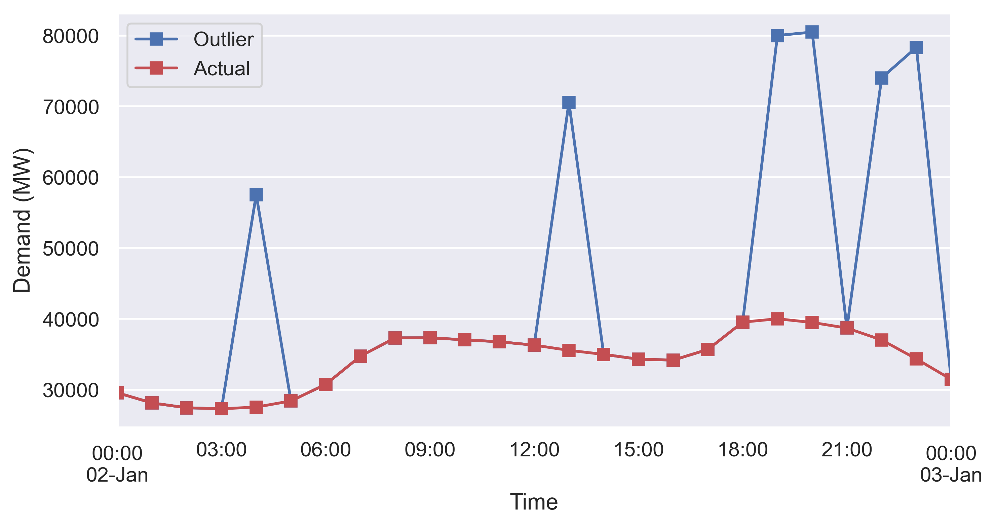
Outlier Detection (PyOD-KNN):
Original data
Data with outliers
Outlier detection results
Manually added outliers

